Slide 1
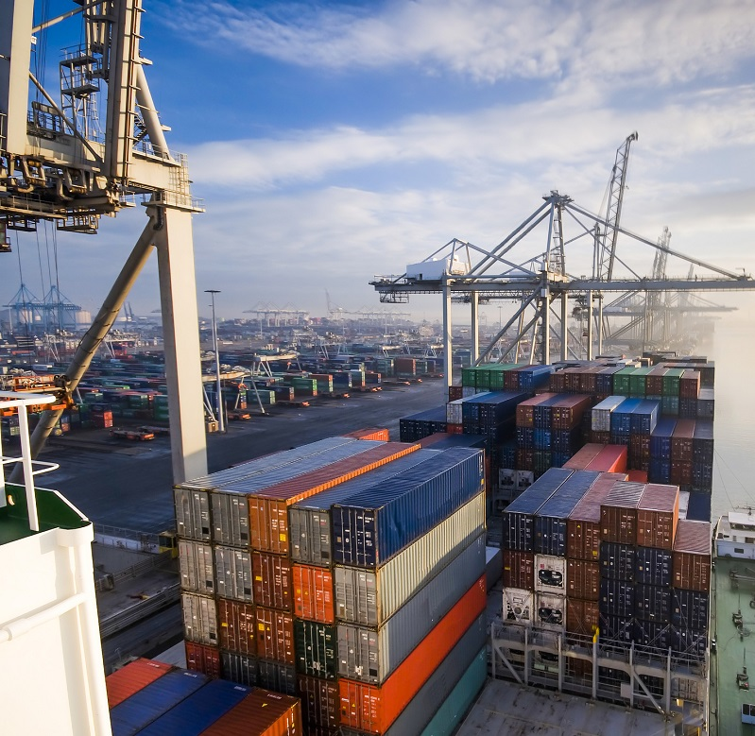
Docker 101 : Getting started
SAGAR UTEKAR | Nov 26, 2022

Slide 2
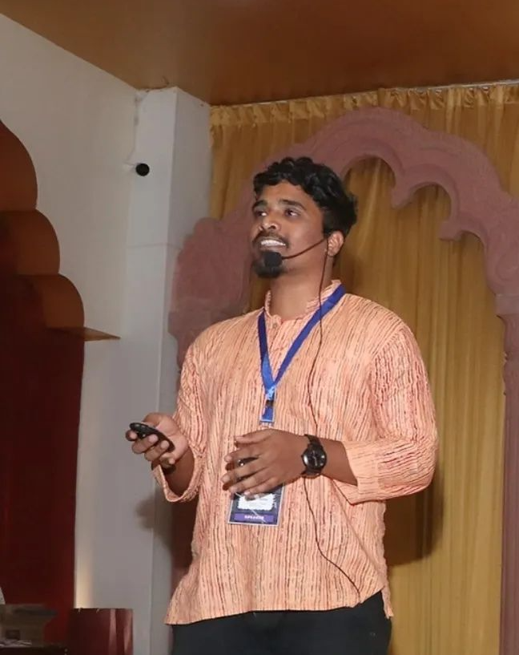
$WHOAMI
Sagar Utekar
Open-source Enthusiast
Site Reliability Engineer @VMWare Software India PVT. LTD.
Google Summer Of Code Admin, Mentor, Mentee
Docker & Kubernetes Pune meetup Organizer
CKS | CKA | CKAD | Terraform certified
Mentored 5000+ students & professionals across India for Career
Guidance, Job search, Open Source, Cloud Computing
m believer in the power of community education.
Google Summer Of Code Admin, Mentor, Mentee 2022 @PEcMentored 5000+ students & professionals across India for career guidance, Job Search, Open Source, Cloud Native
Twitter : @me_sagar_utekar
Github : Sagar2366

Slide 3

Agenda
Docker Overview
Why do we need Docker ?
VM’s VS Containers
Architecture
Docker Installation
Terminologies
CLI Commands
Demo
Contribute to Open Source & GSoC
Q&A

Slide 4
Docker Overview
Docker is a Company, Product, Platform, CLI Tool, Computer Program
Standardized packaging for software and dependencies
Isolate apps from each other
Works for all major Linux distributions, Windows, MAC
Guaranteed to run the same way - Your development desktop, a bare-metal server, virtual machine, data centre, or cloud
A tool that can package an application and its dependencies in a virtual container.
Docker uses host OS kernel, there is no custom or additional kernel inside container. All containers runs on machine are sharing this "host" kernel.
Docker uses resource isolation features of the Linux kernel such as cgroups and kernel namespaces to allow independent "containers" to run within a single Linux instance, avoiding the overhead of starting virtual machines.

Slide 5
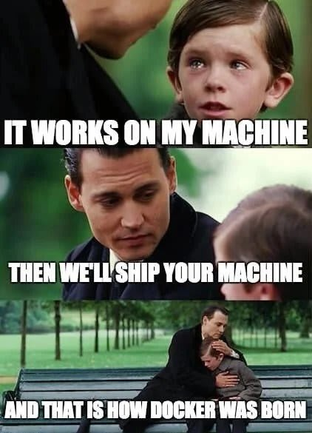
Why do we need Docker ?

Slide 6
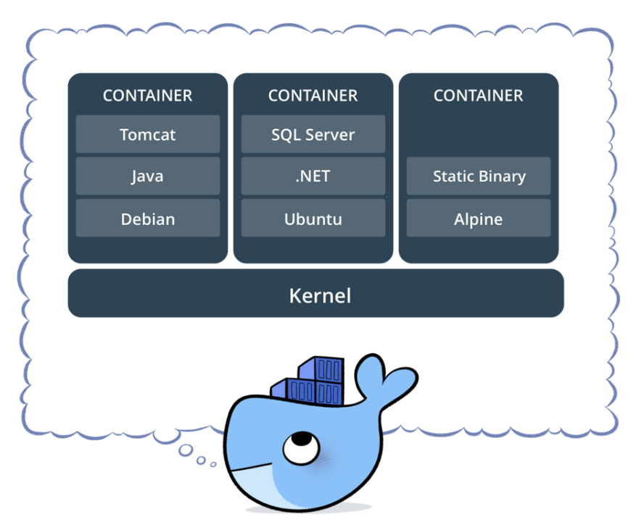
Why do we need Docker ?
Libraries, OS Compatibility/Dependency issues
Fast in bootstrap, setup and operations time
Run same app with different versions
Different Dev/Test/Prod Environments
To deploy application newer versions faster
Built form loosely coupled components
We don’t need an entire operating system,
just some components to make everything up and run.
Lower memory footprint, Lightweight, Easy to ship, share, run
m believer in the power of community education.
Google Summer Of Code Admin, Mentor, Mentee 2022 @PEcMentored 5000+ students & professionals across India for career guidance, Job Search, Open Source, Cloud Native

Slide 7
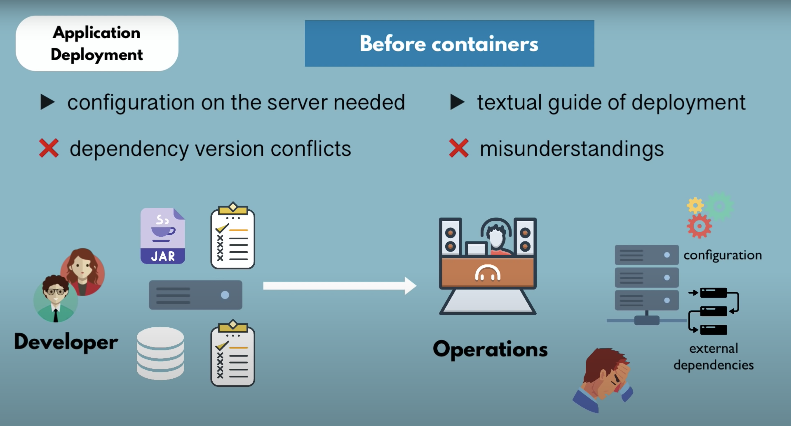
Why do we need Docker ?

Slide 8
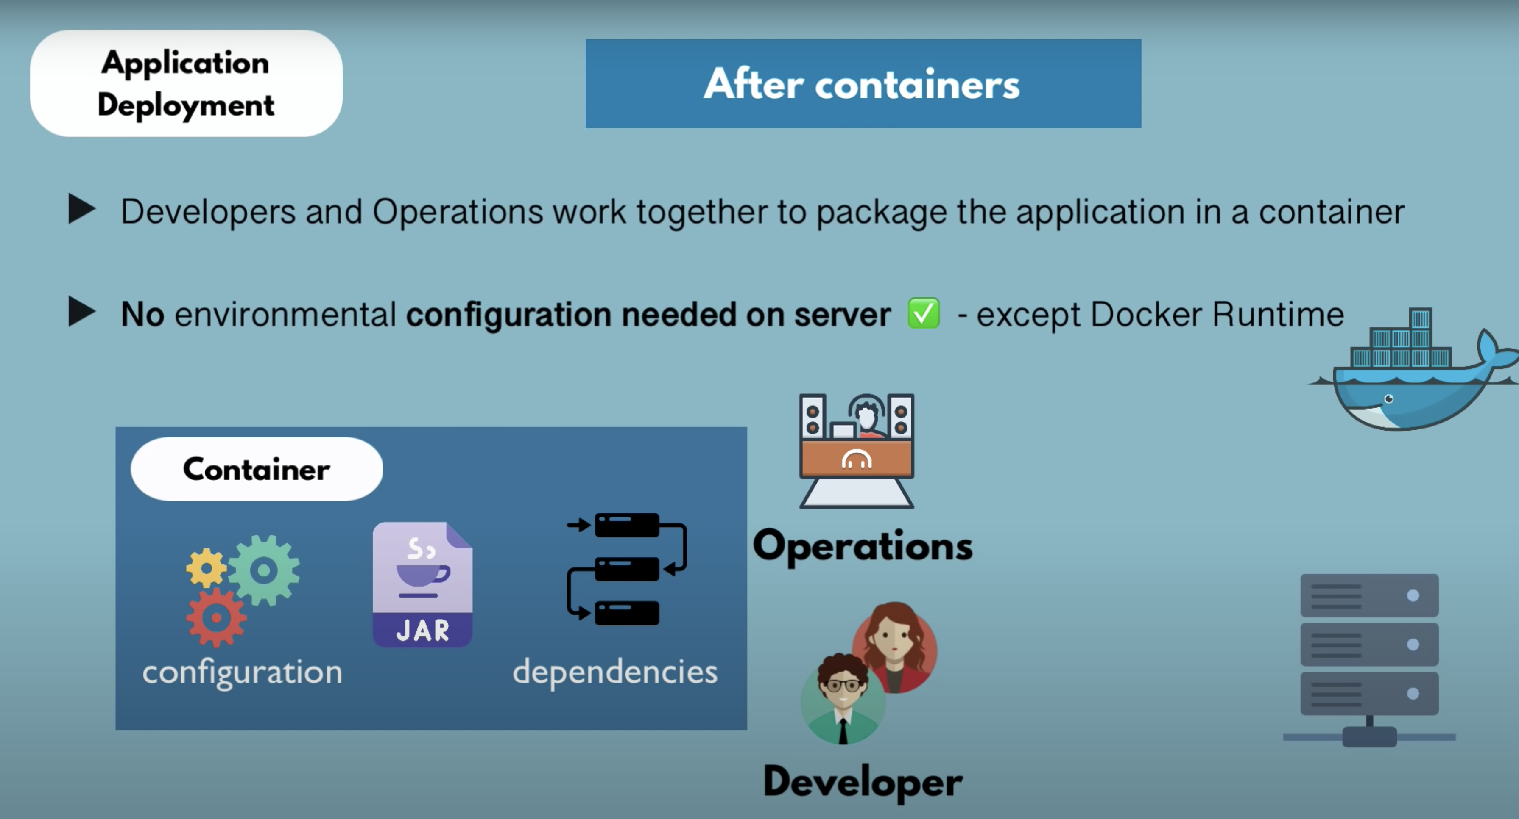
Why do we need Docker ?

Slide 9
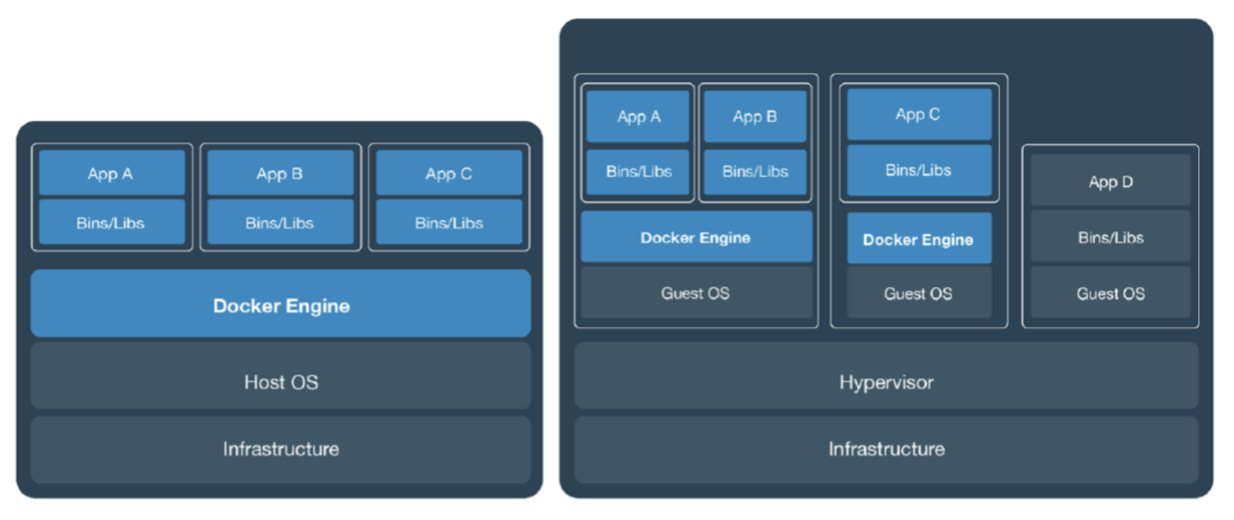
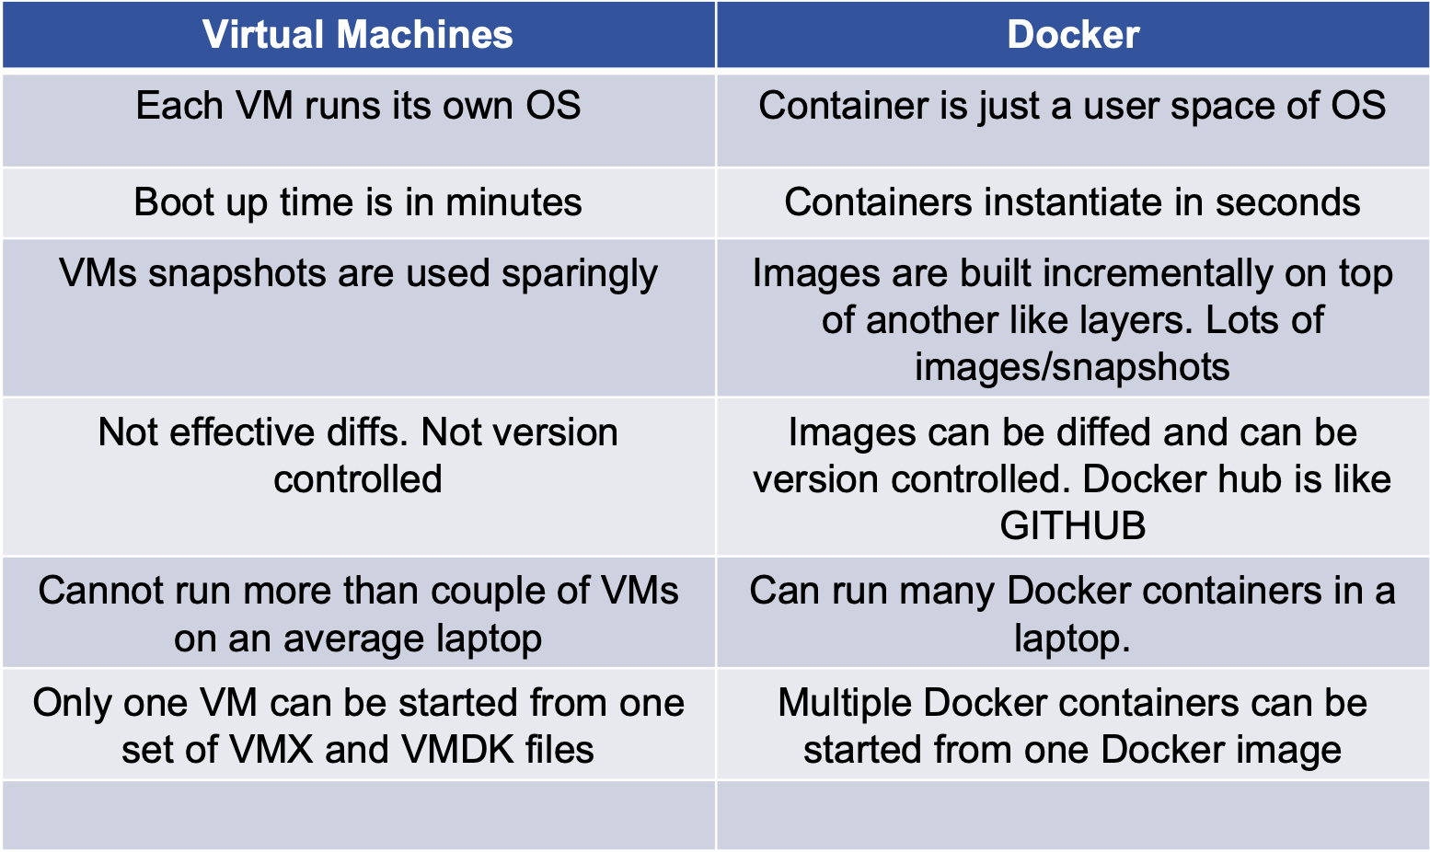
Virtual Machines VS Docker Containers

Slide 10

Docker Architecture

Slide 11

Docker Installation
MAC - https://docs.docker.com/desktop/install/mac-install/
Linux - https://docs.docker.com/desktop/install/linux-install/
Windows - https://docs.docker.com/desktop/install/windows-install/

Slide 12

Terminologies
Docker Images - The basis of a Docker container, Represents a full application, package or template used to create contianer
Docker Containers - A way to package application with all the necessary dependencies and configurations. Portable artifact, easily shared and moved around, running instance of an image.
Docker Engine - Creates, ships and runs Docker containers deployable on a physical, virtual, host locally, in datacenter or cloud
Docker registry - Cloud or server-based storage and distribution sevrice for your images

Slide 13
Docker CLI Commands
DEMO
Create DockerHub Account
Open https://play-with-docker.com
Hello Whale Example
Build Your First Docker Image & Push it to DockerHub
1. Pulling Docker Image
$ docker pull sagar2366/hellowhale
2. Listing out Docker Images
$ docker image ls
3. Running Docker Containers
$ docker run –d –p 5000:5000 –-name hellowhale sagar2366/hellowhale
4. Stopping the container
$ docker stop hellowhale (or <container-id>)

Slide 15
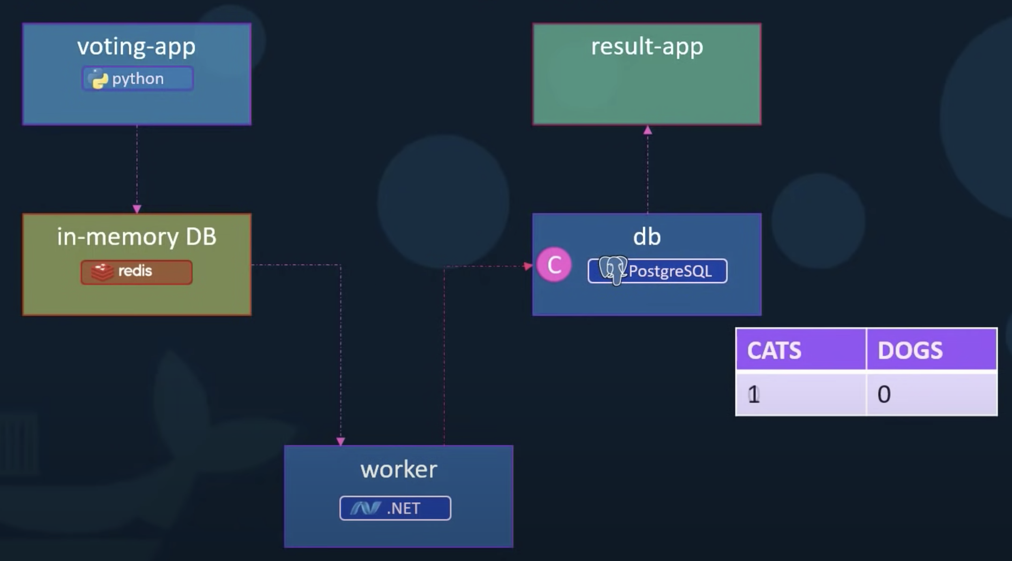
Sample Voting application
https://github.com/dockersamples/example-voting-app.git

Slide 16
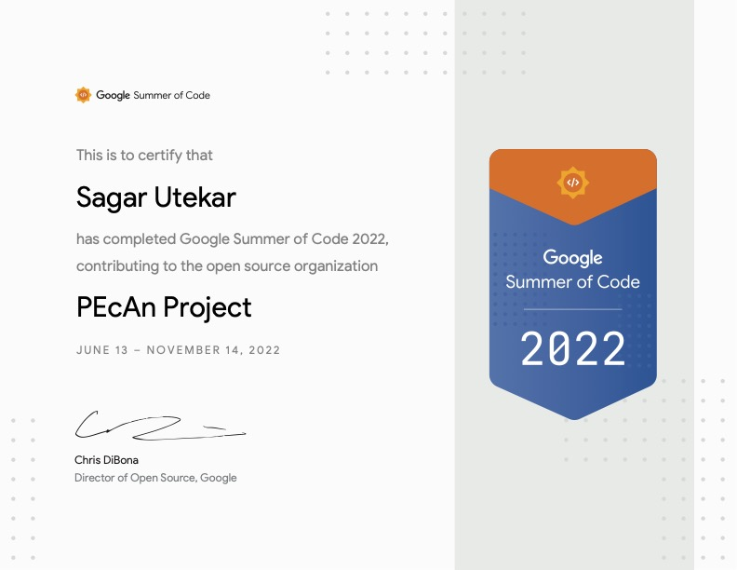
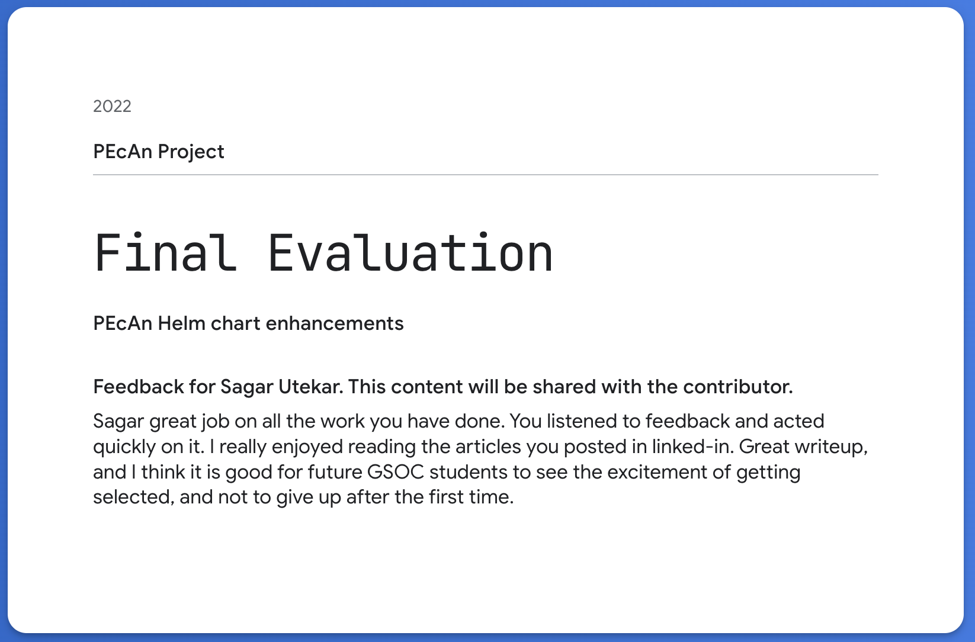
Experience of contributing to Open Source & GSoC

Slide 17
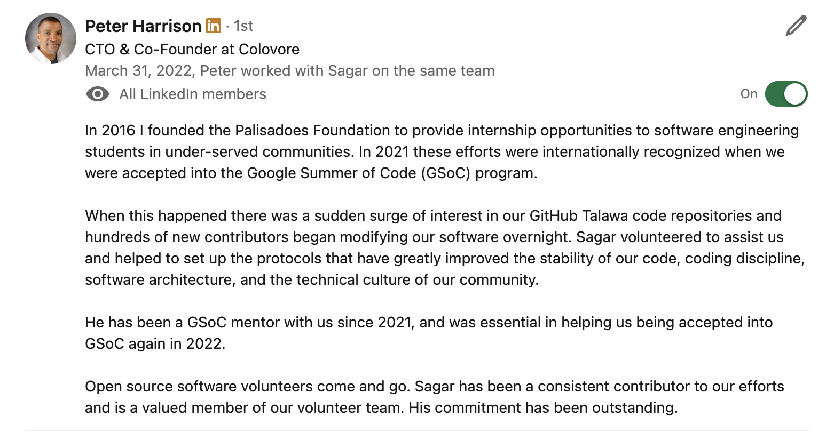
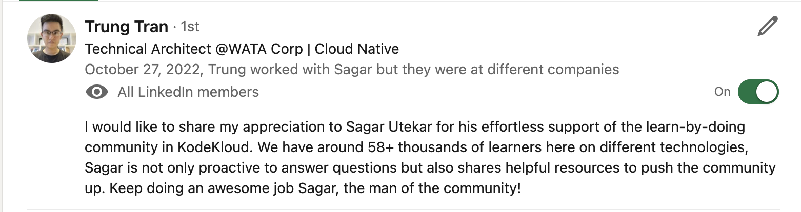
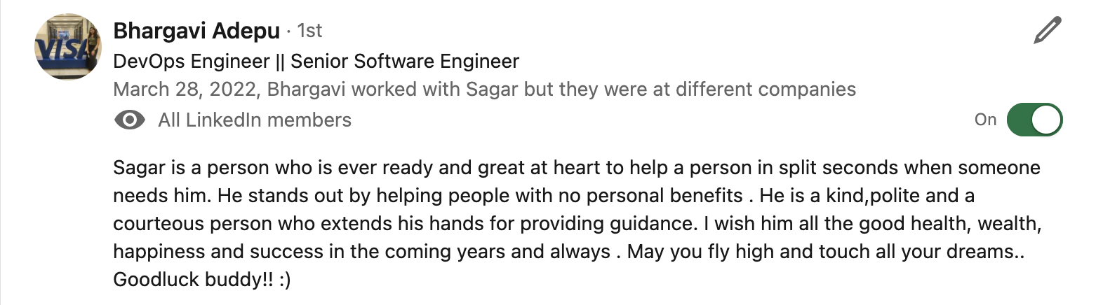
TESTIMONIALS

Slide 18
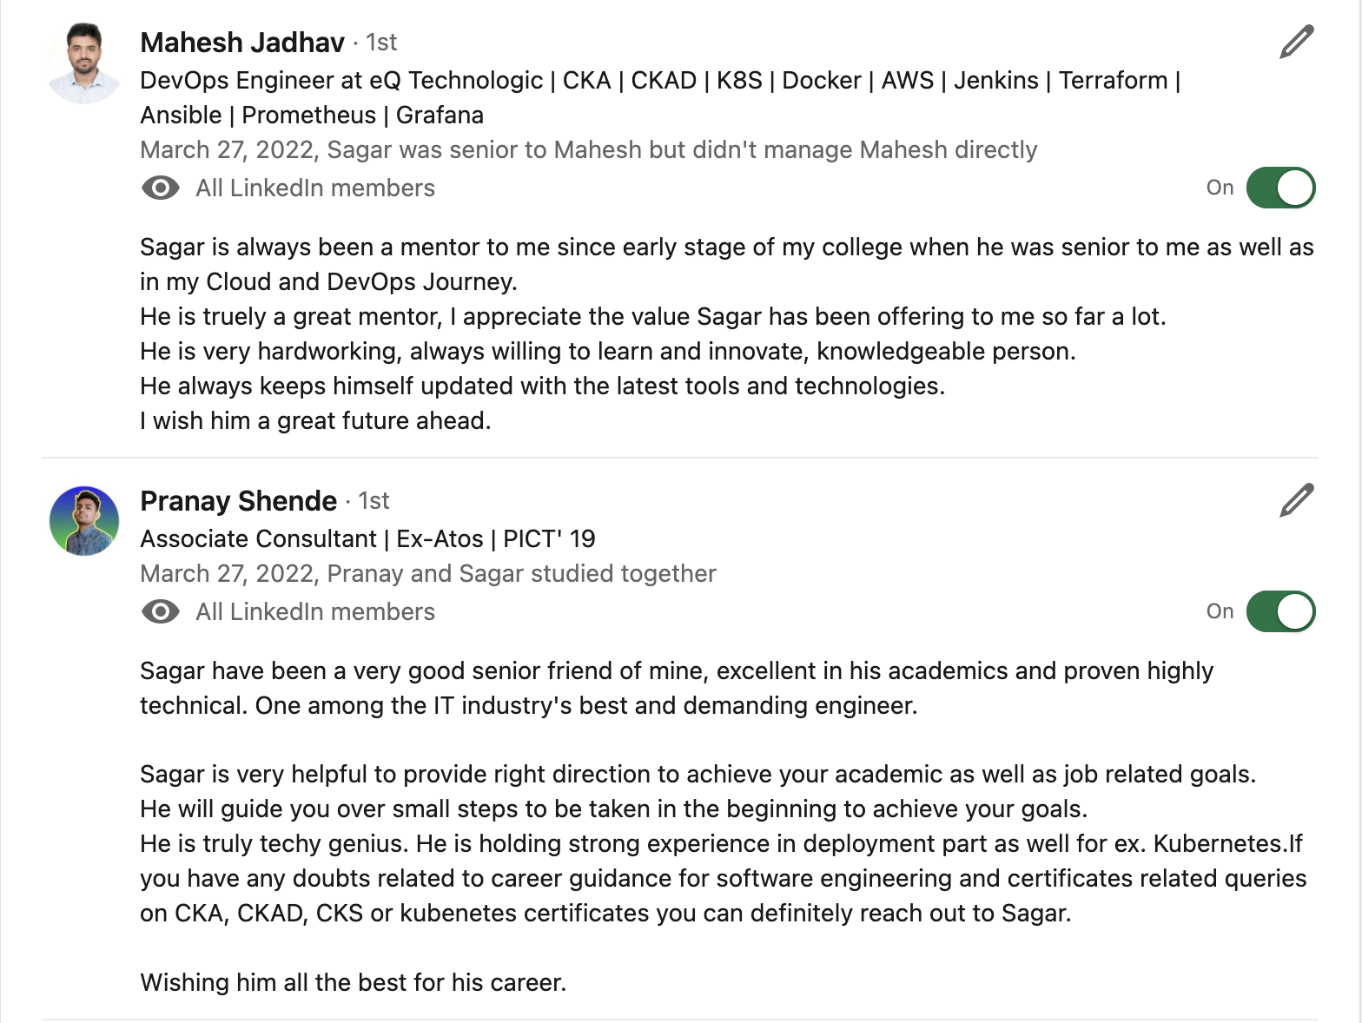
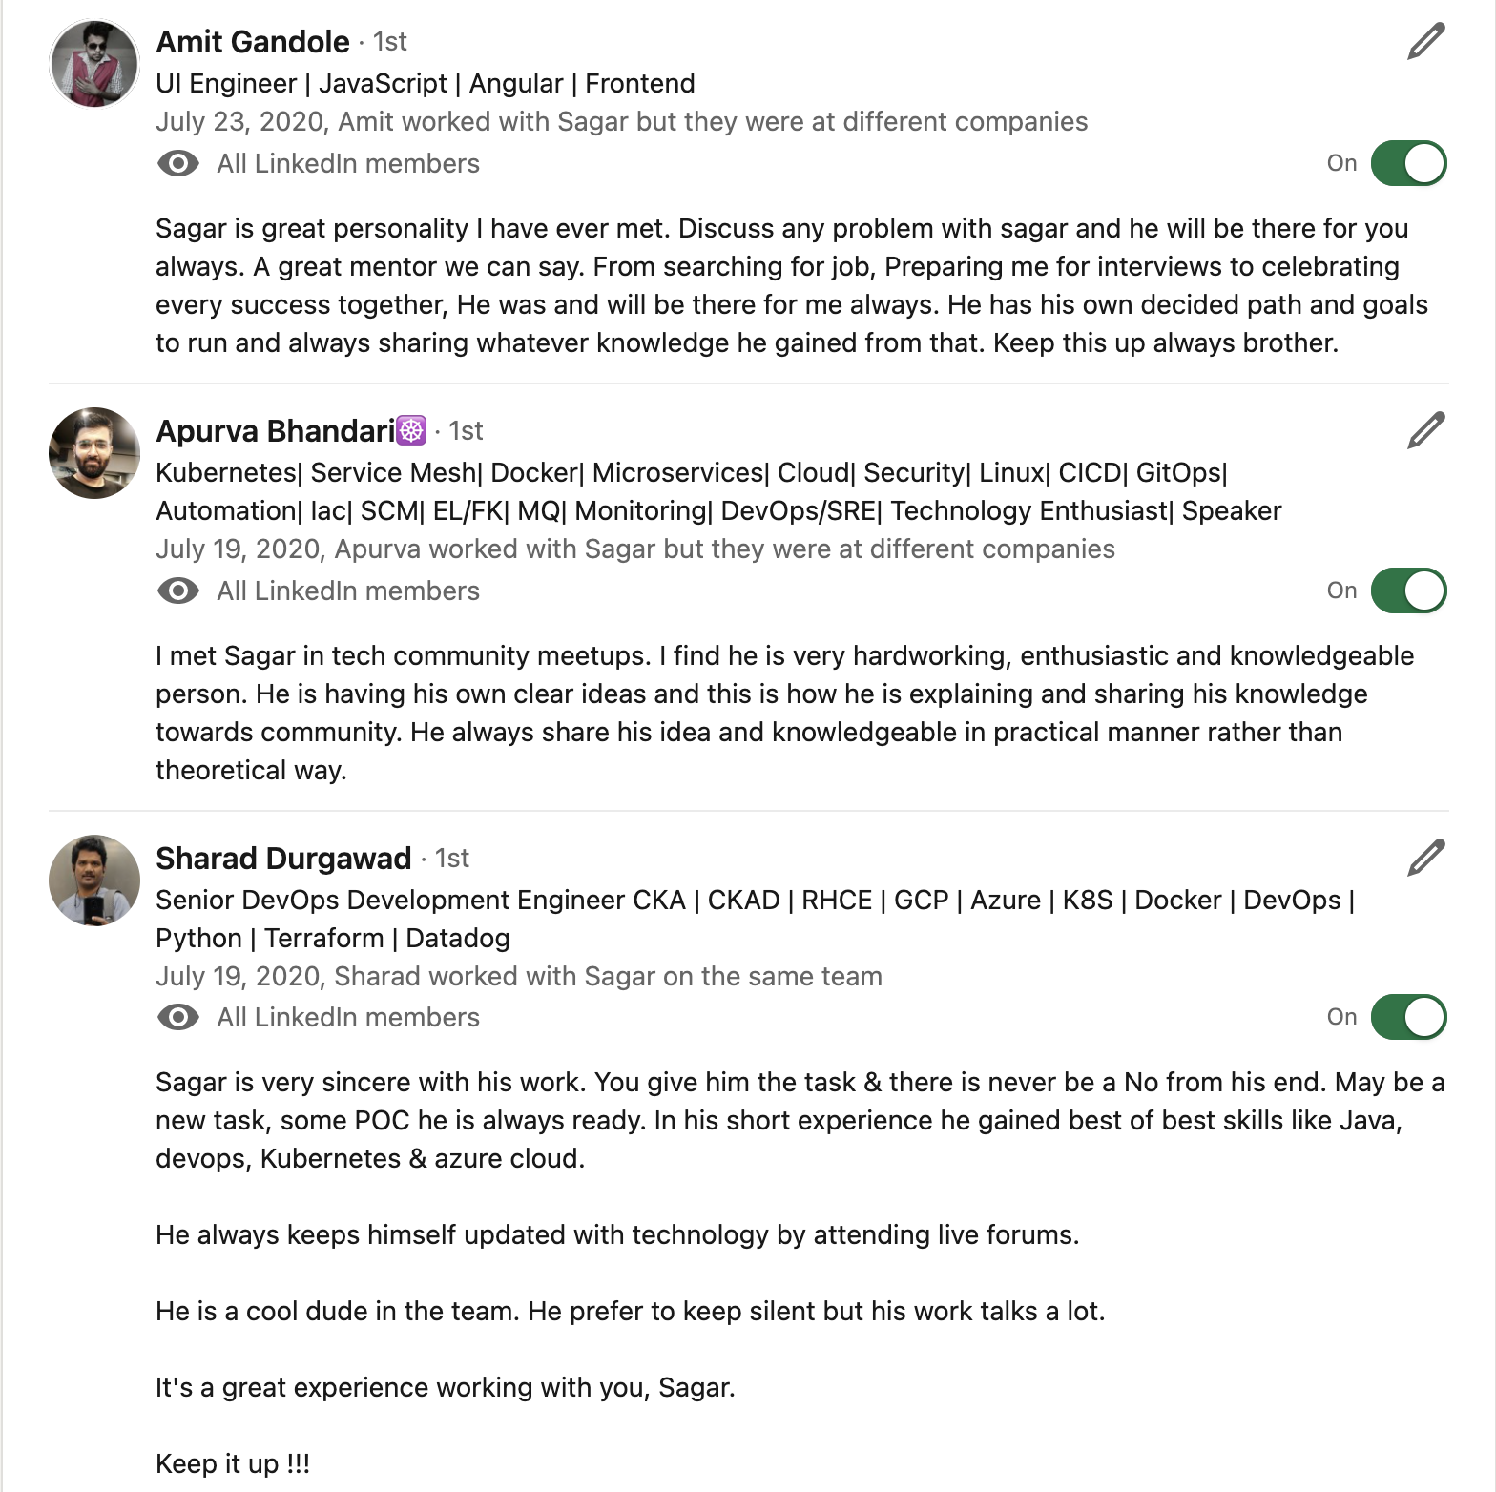
TESTIMONIALS

Slide 19

ANY QUESTIONS ?

Slide 20

Thank You
Docker Pune Slack - https://join.slack.com/t/dockercommunity/shared_invite/zt-1k5st1ts3-IDvhitv6gyD7IOBeLS0m_A
Docker Pune LinkedIn - https://www.linkedin.com/groups/9264407/ Contact us if you would like to help/volunteer/collaborate/sponsor for upcoming events.

